Slide 1

SURVEY RESULTS - SLOVAKIA
Jaromír Šimonek
CPU Nitra, Slovakia
Budapest, June 2016

Slide 2
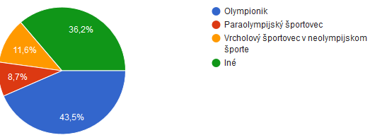
ATHLETE INFORMATION

Slide 3
FIELD OF SPORT
Athletics | 11
Shooting | 9
Cycling | 7
Canoeing | 5
Water slalom | 3
Other sports: judo, archery, swimming, alpine skiing, tennis, weightlifting, short track, skiing, rowing, table tennis, triathlon, judo, bodybuilding, karate, trial, duathlon, boxing, acrobatic skiing, luge, biathlon, fitness, synchronized swimming, boccia, kickbox.

Slide 4
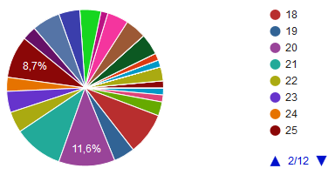
AGE

Slide 5
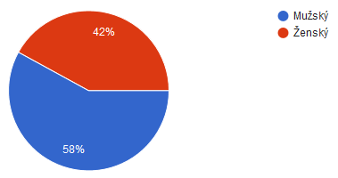
GENDER
Male - 58%
Female - 42%

Slide 6
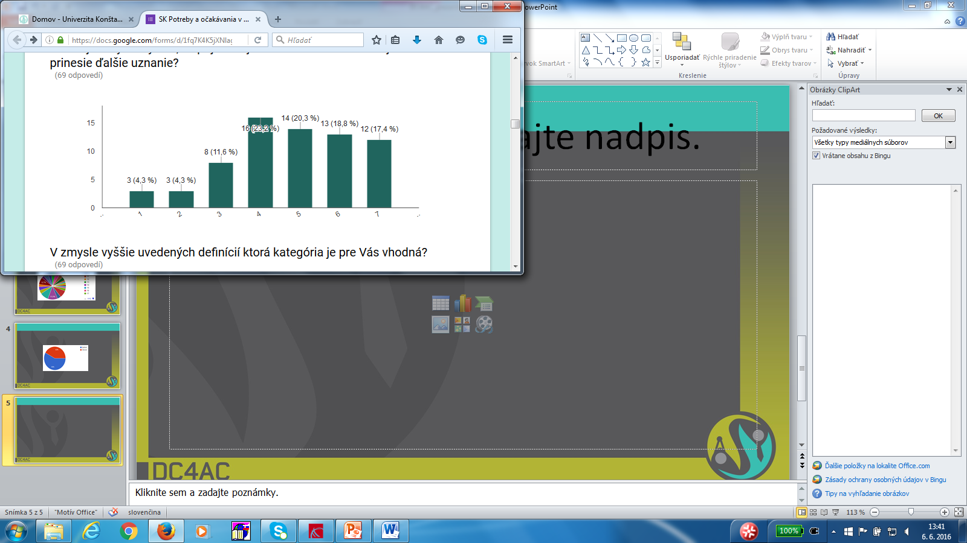
TO WHAT EXTENT, DO YOU CONSIDER THAT THE ADOPTION OF THIS CLASSIFICATION WOULD BRING AN ADDITIONAL RECOGNITION?

Slide 7
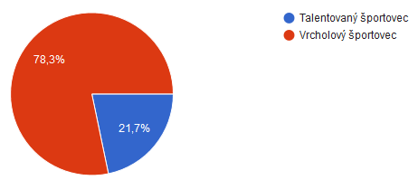
IN THE LIGHT OF THE DEFINITIONS MENTIONED ABOVE, WHAT CATEGORY IS MORE APPROPRIATE FOR YOU?
Talented athlete – 21.7%
Elite athlete – 78.3%

Slide 8
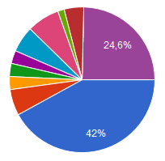
FINISHED EDUCATION
42.0 % - no university education
24.6 % - university education
32.4 % - passed at least one semester at the university

Slide 9
CHANGES OF EXPECTATIONS
(1)„No special expectation until 23, no particular aims, but shortly after 23 my aims were focused on OG/WC/EC“.
(2)“I wanted to penetrate into the world top class but with the conditions in Slovakia my dreams vanished...“
(3)“I expected more than I received...“
(4)“I expected nothing because I live in Slovakia and after my experience with getting nothing after being third twice at EC I am not expecting anything now...“

Slide 10
CHANGES OF EXPECTATIONS
(5)“I started my career in 1989, when the provision of my sport was on a very high level. After the fall of communism and spreading of CZ and SVK the conditions went poorer, but after 2000 the situation has been improving“.
(6)“I expected some financial support from the sport association or state, as well as from the school in the form of an individual arrangement of the study, but nothing has happened“.

Slide 11
CHANGES OF EXPECTATIONS
(7)“I started with track and field as a student. Now, I am an Olympian but do not belong to any top sport centre so the main problem is to find a source of basic income for my living“.
(8)“I have always been keen on sport. Nothing has changed since then but I´m more and more aware of the fact that sport will not be my source of living and I start to think about my new job more now“.

Slide 12
CHANGES OF EXPECTATIONS
(9)“I expected different level of conditions in my sport when I become elite athlete. In cycling the conditions have not changed since my childhood in Slovakia. Support in woman´s cycling is very poor everywhere...“.

Slide 13
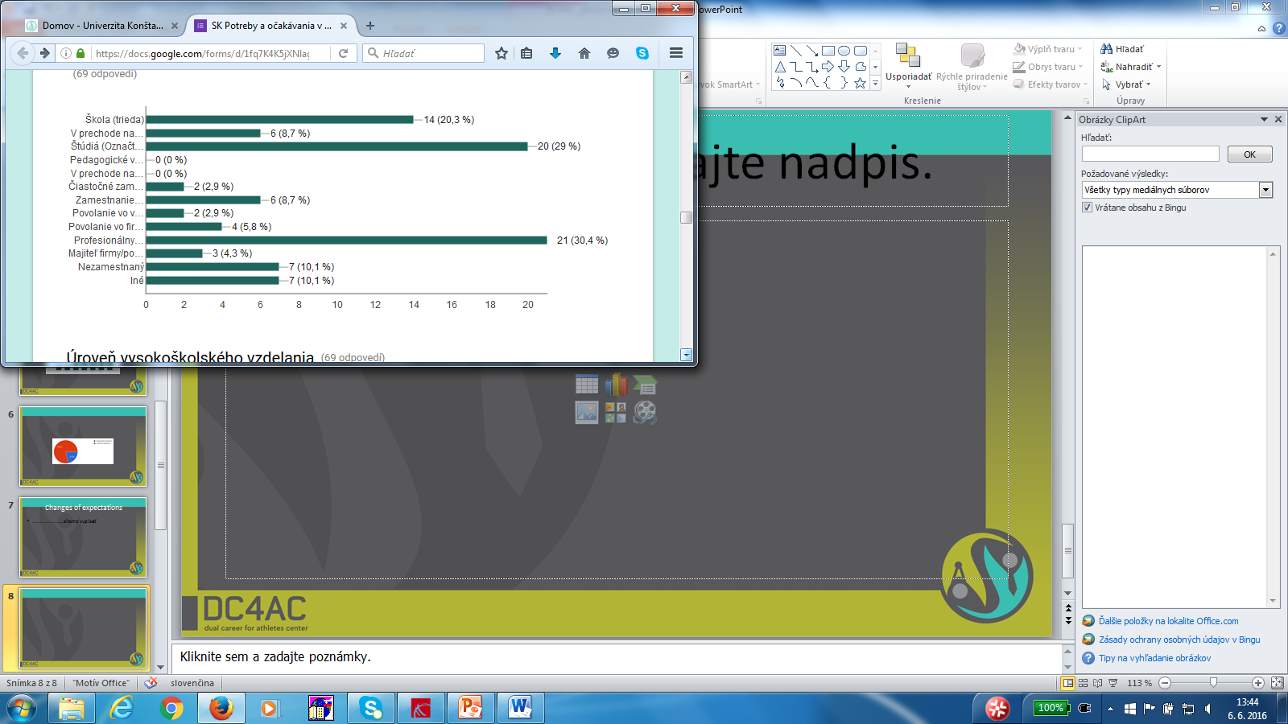
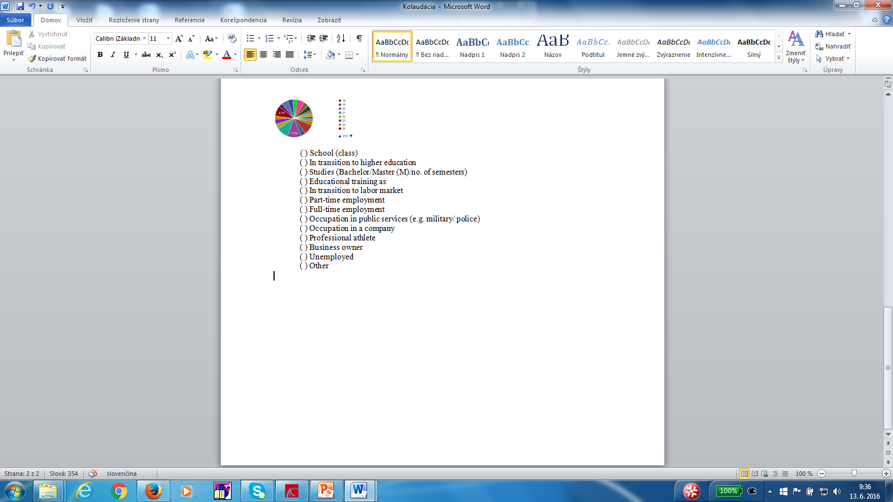
WHAT IS YOUR OCCUPATION NEXT TO SPORTS?

Slide 14
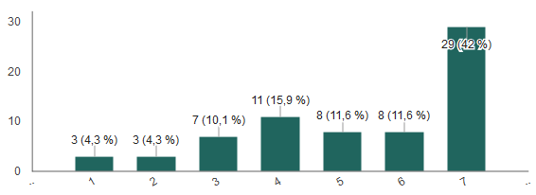
OFTEN, ATHLETES ARE FORCED TO COMBINE SPORTS WITH EDUCATION/JOB CAREER. TO WHAT EXTENT DO YOU/HAVE YOU MANAGED THIS CHALLENGE?

Slide 15
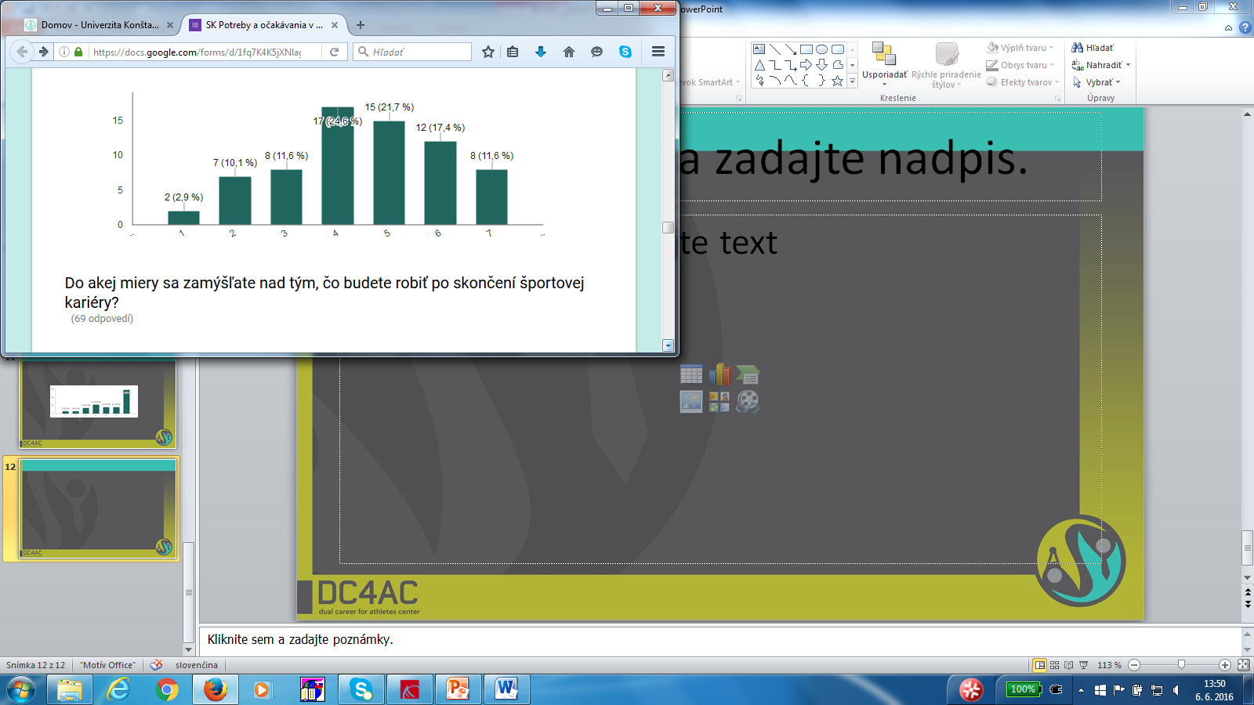
TO WHAT EXTENT DO YOU CONSIDER YOURSELF PREPARED FOR LIFE, BEYOND ATHLETIC CAREER?

Slide 16
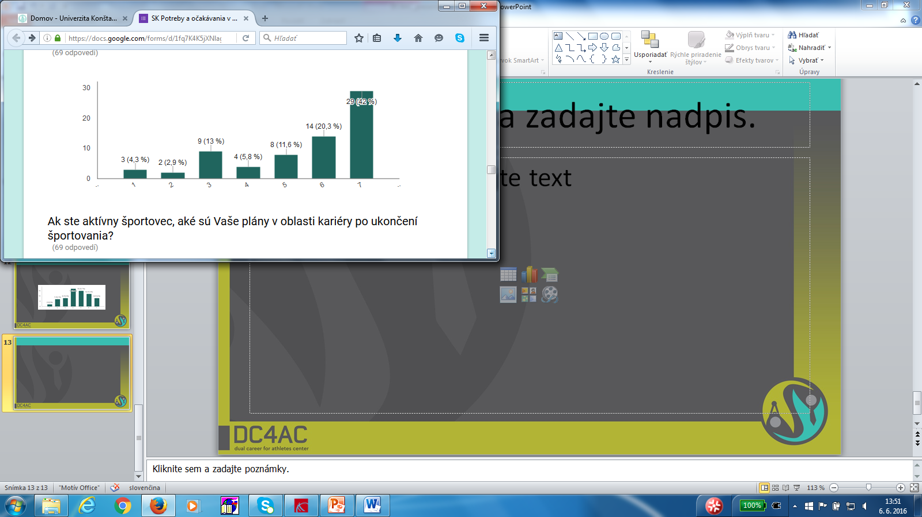
TO WHAT EXTENT DO YOU THINK ABOUT WHAT YOU ARE GOING TO DO AFTER ENDING THE SPORT CAREER?

Slide 17
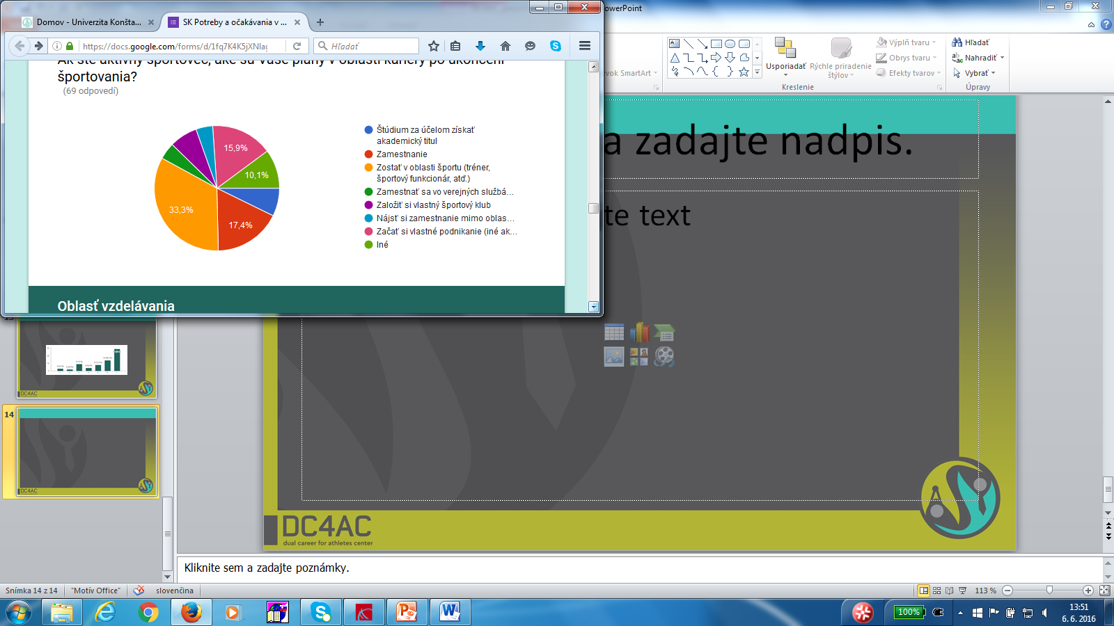
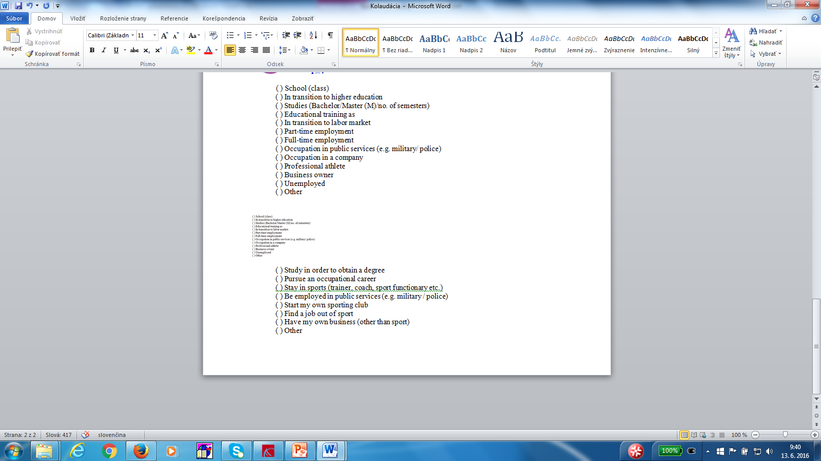
IF YOU ARE AN ACTIVE ATHLETE, WHAT ARE YOUR PLANS FOR YOUR POST-ATHLETIC CAREER?

Slide 18
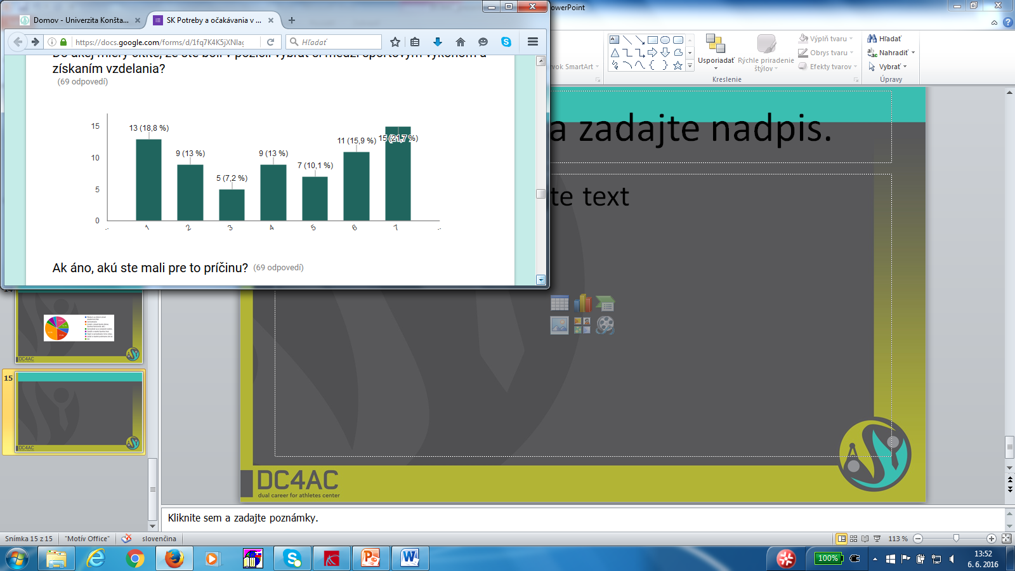
TO WHAT EXTENT DO YOU FEEL THAT YOU´VE BEEN PUT IN A POSITION TO CHOOSE BETWEEN SPORT PERFORMANCE AND FULFILLING EDUCATION?

Slide 19
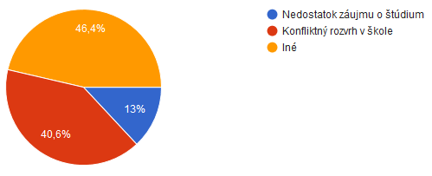
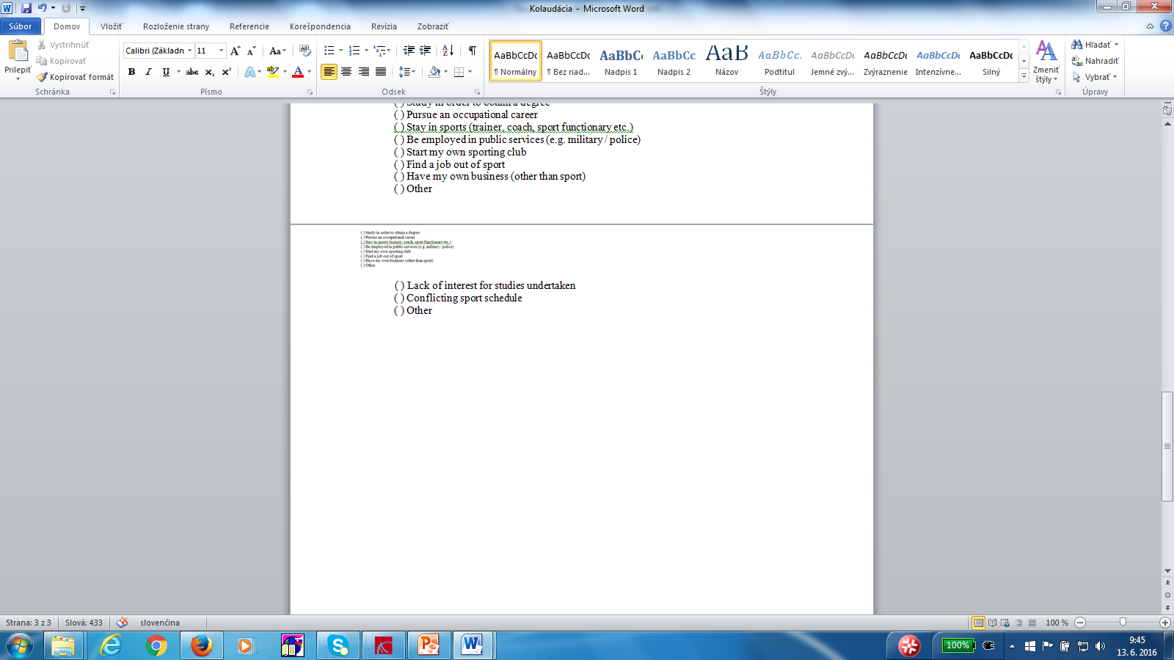
IF YES, WHAT WAS THE REASON FOR DOING SO?

Slide 20
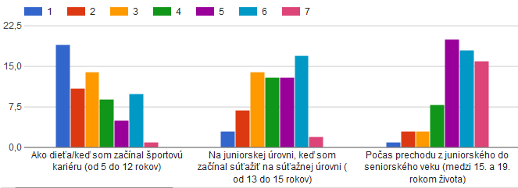
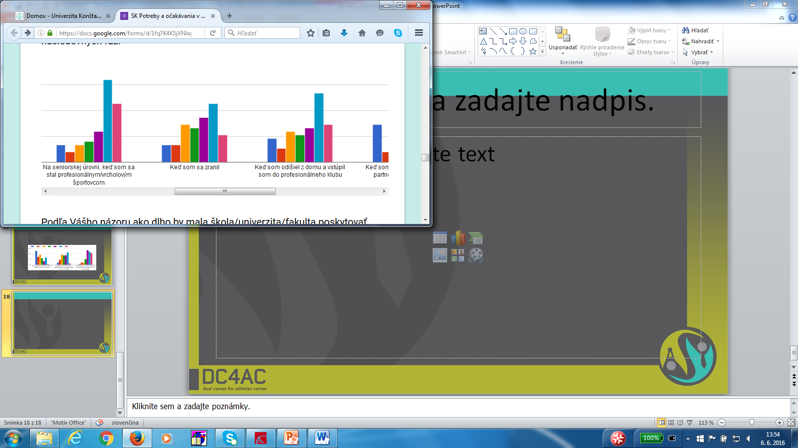
TO WHAT EXTENT DO YOU BELIEVE IT IS NECESSARY TO HAVE A SUPPORT FROM SCHOOL/UNIVERSITY?

Slide 21
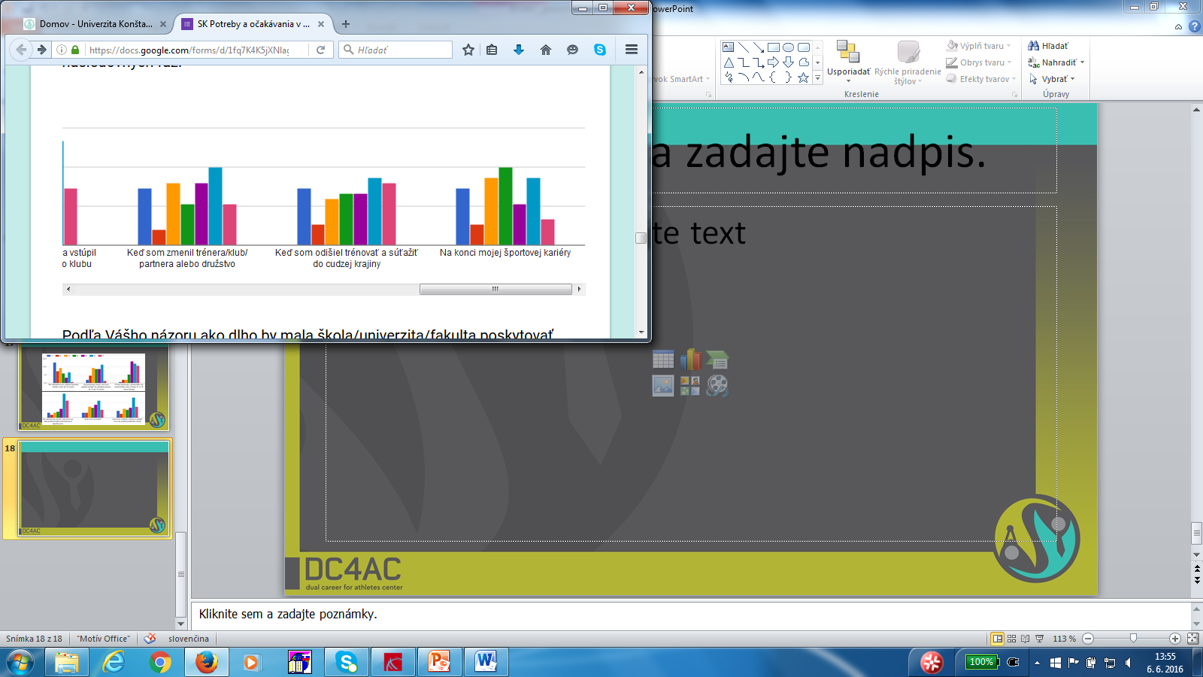
TO WHAT EXTENT DO YOU BELIEVE IT IS NECESSARY TO HAVE A SUPPORT FROM SCHOOL/UNIVERSITY?

Slide 22
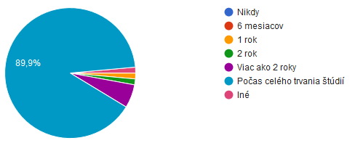
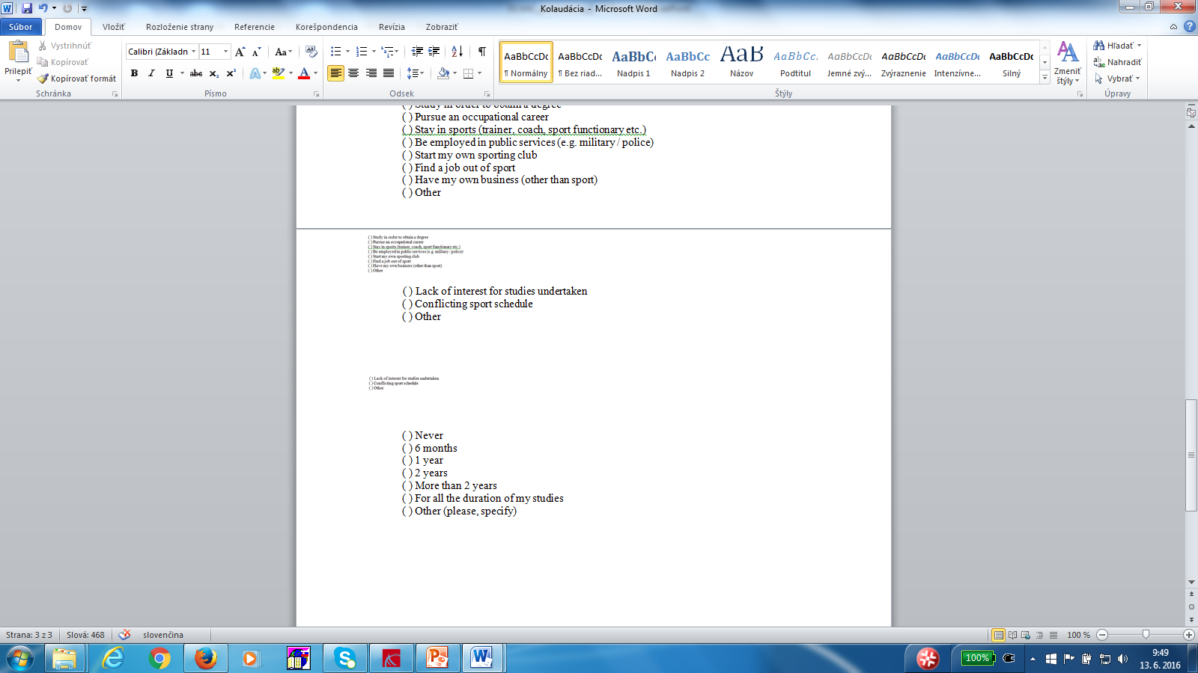
In your opinion, how long should the School provide help for your dual career?

Slide 23
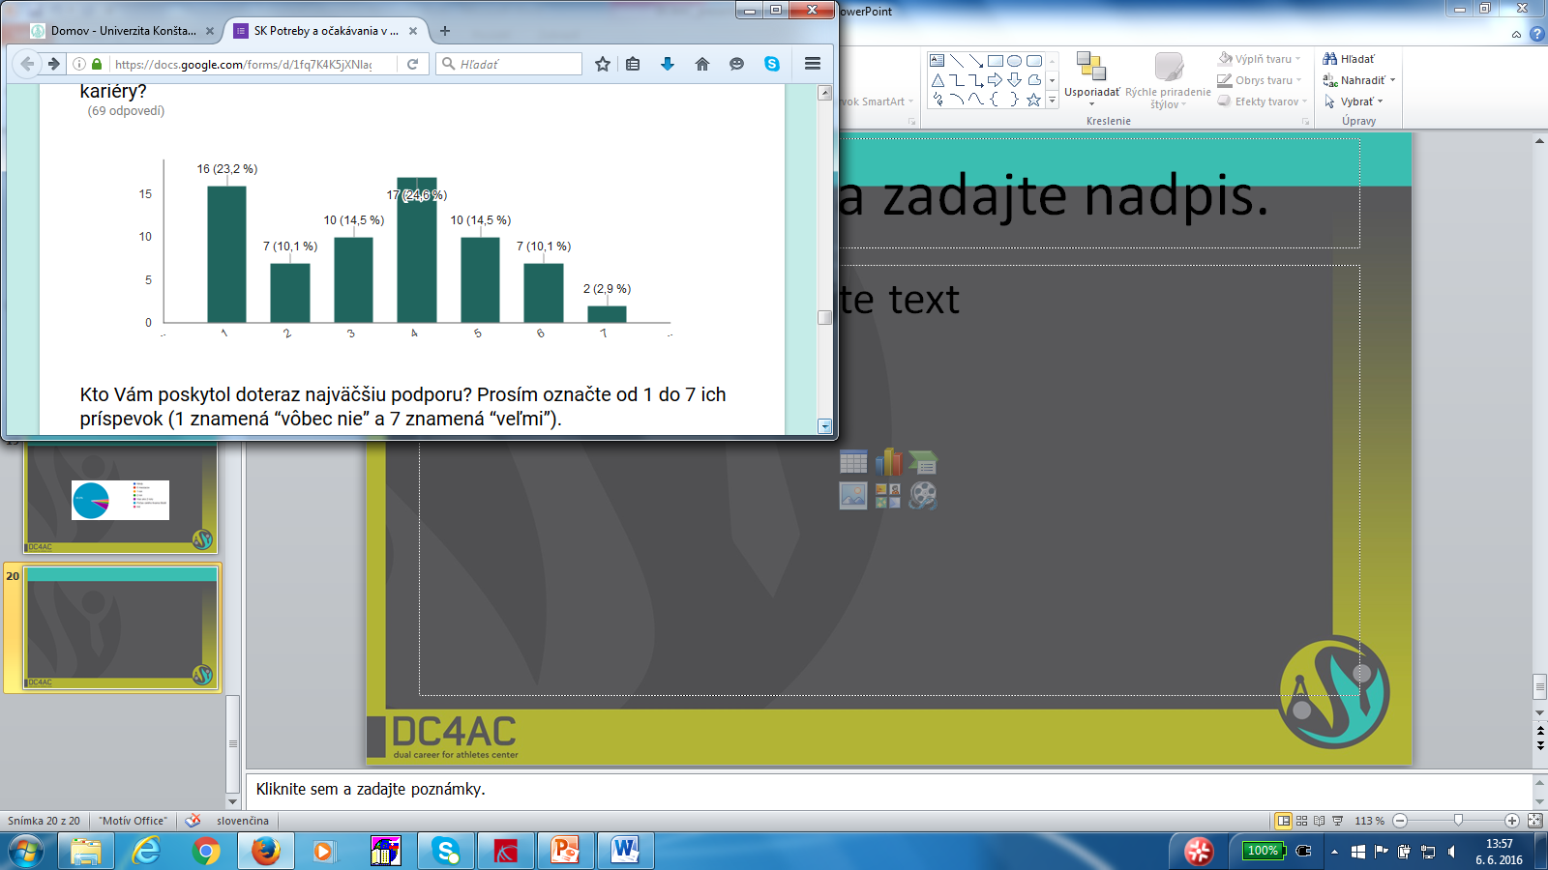
Do you consider that until now you have been supported in the process of developing a dual career?

Slide 24
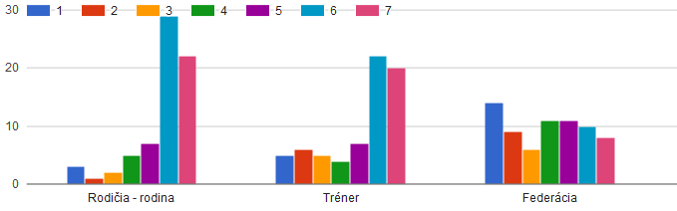
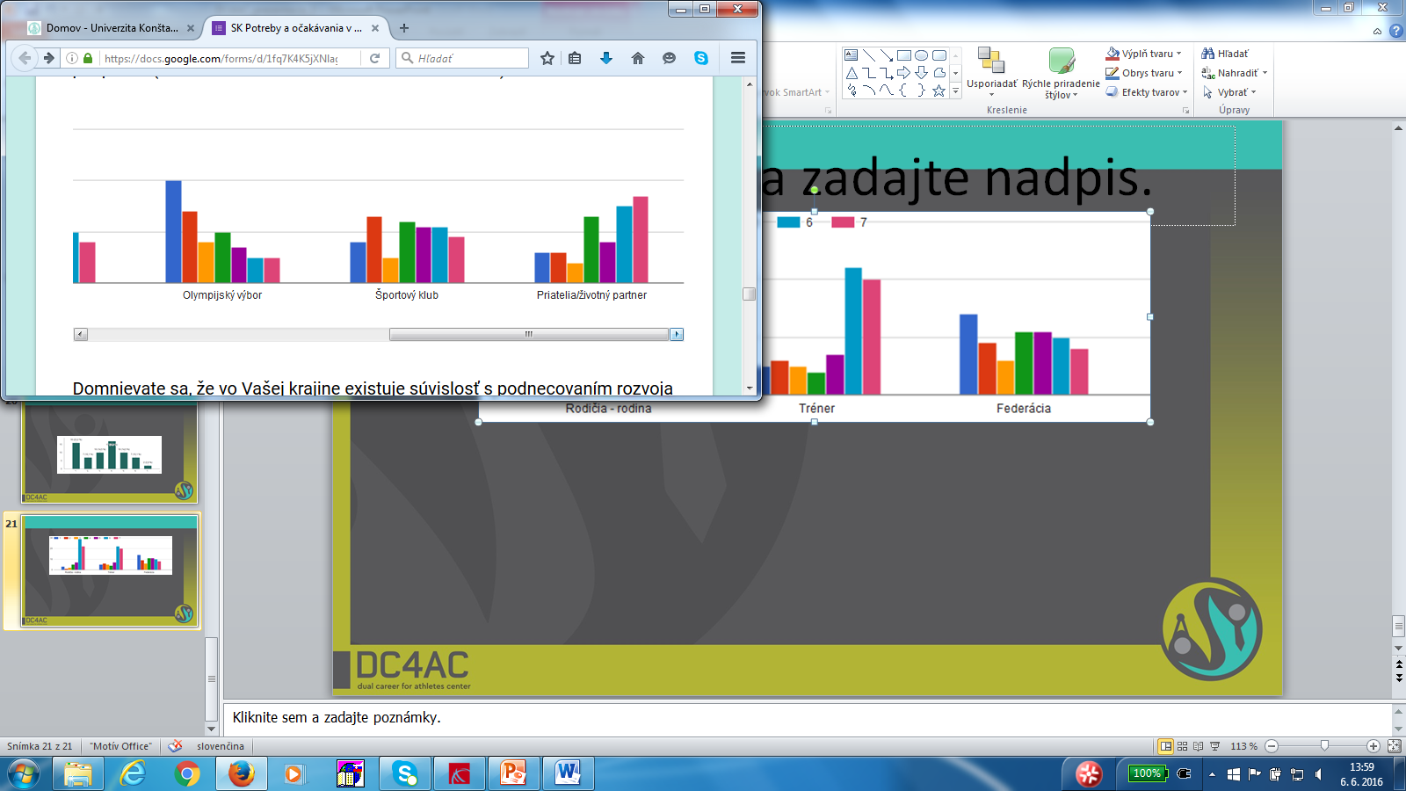
Who do you think that were the main factors of support?

Slide 25
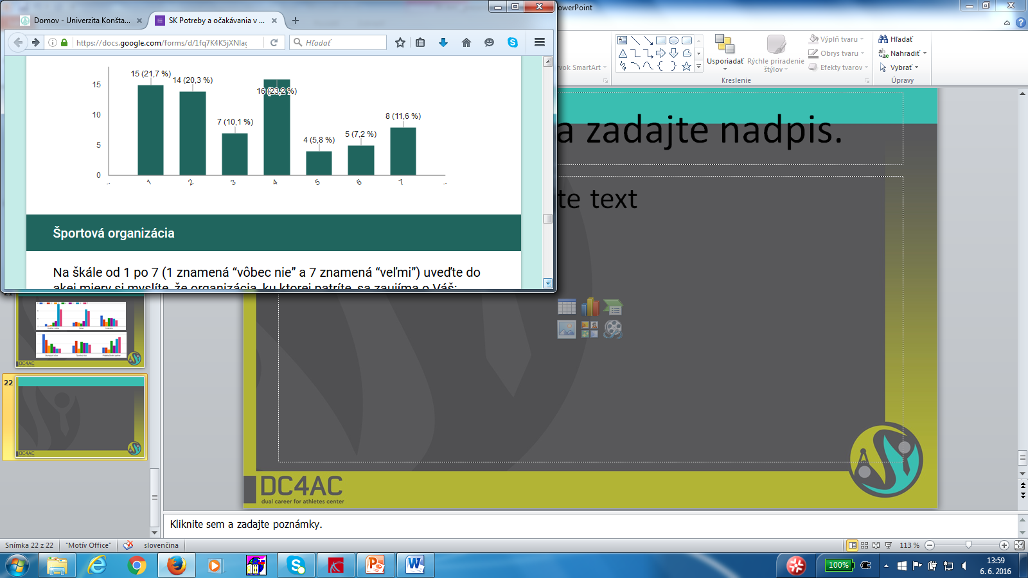
Do you consider that in your country there is a context to encourage the development of dual career for athletes?

Slide 26
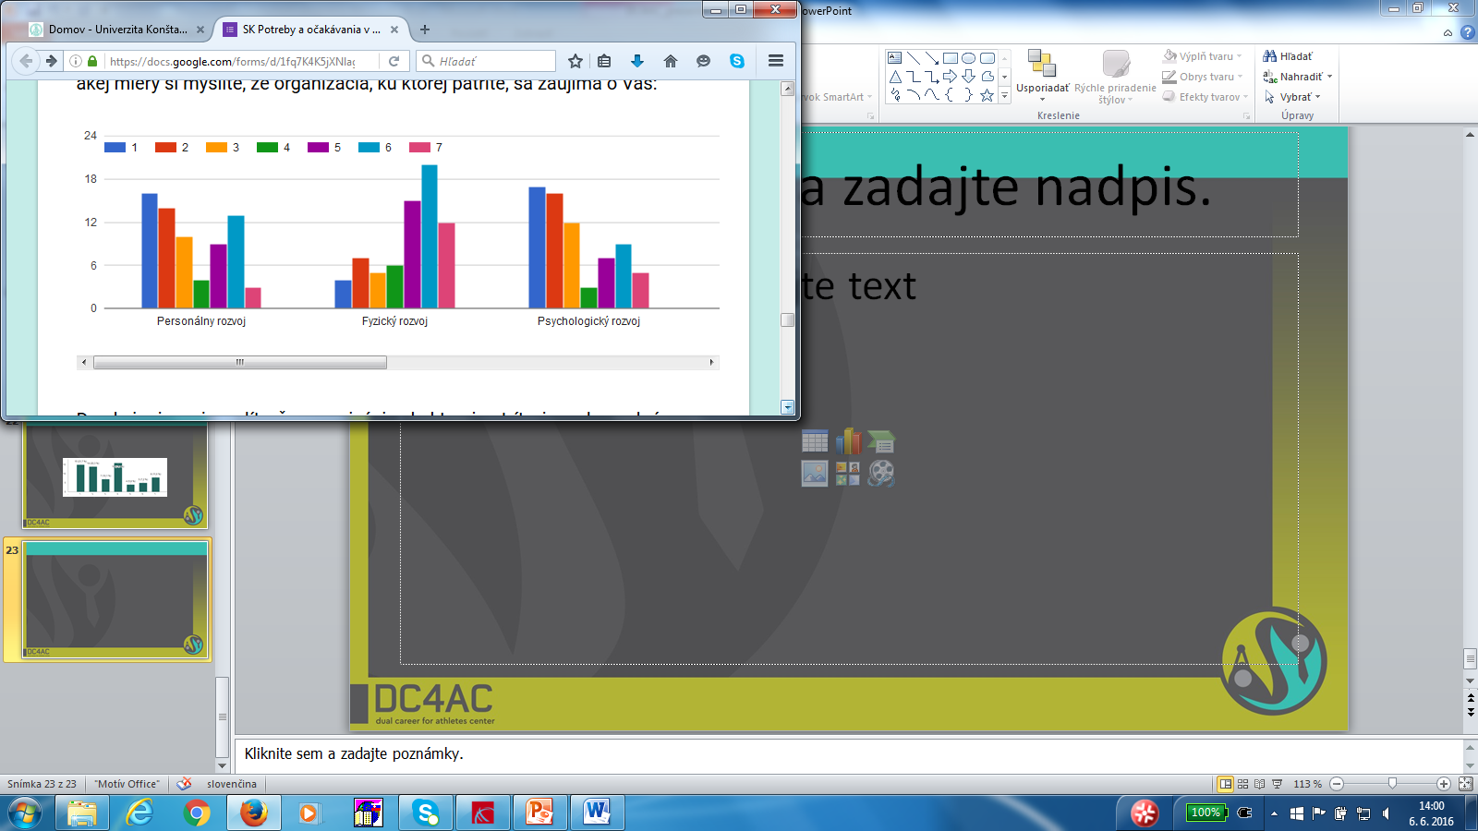
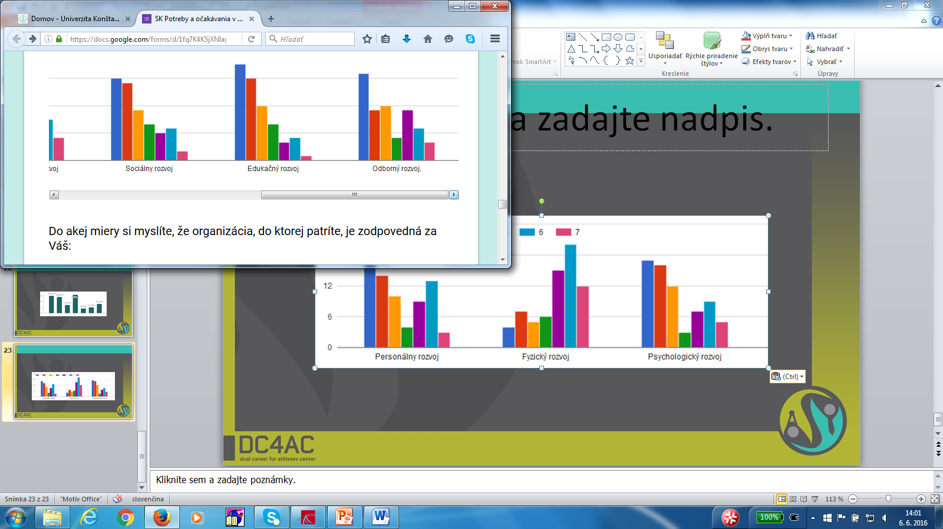
To what extent do you consider that the organization to which you belong is concerned with your:

Slide 27
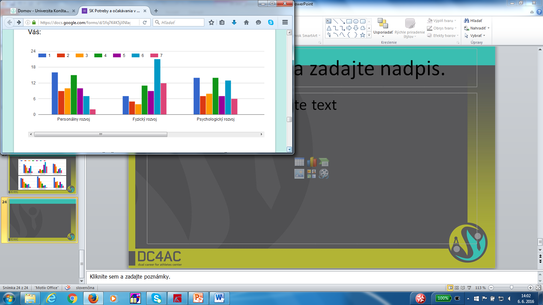
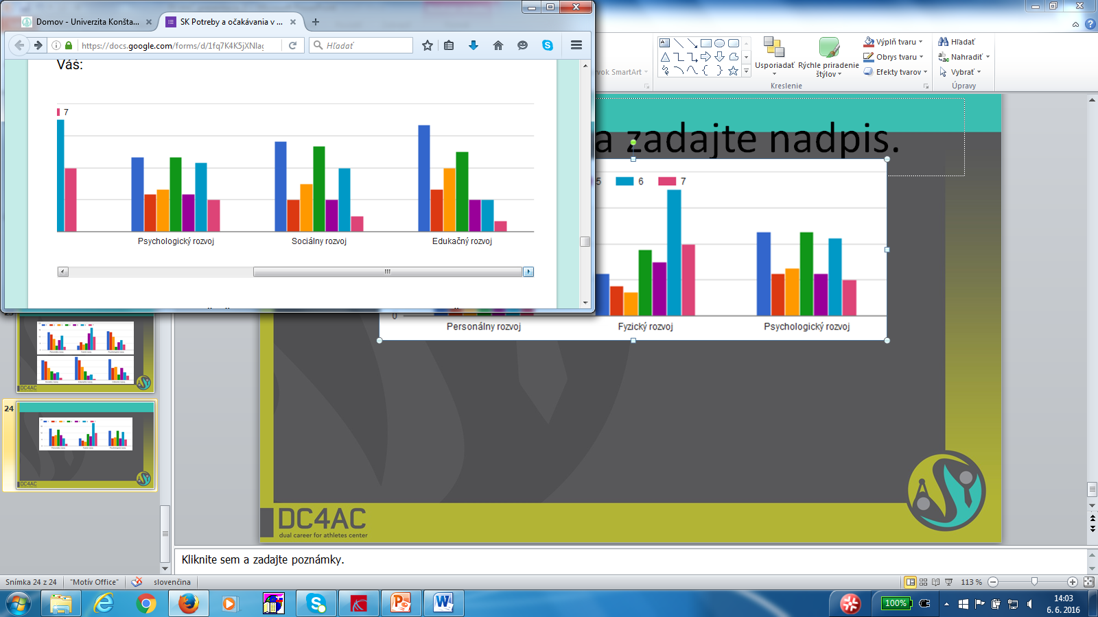
To what extent do you consider that the organization to which you belong to, is responsible for your:

Slide 28
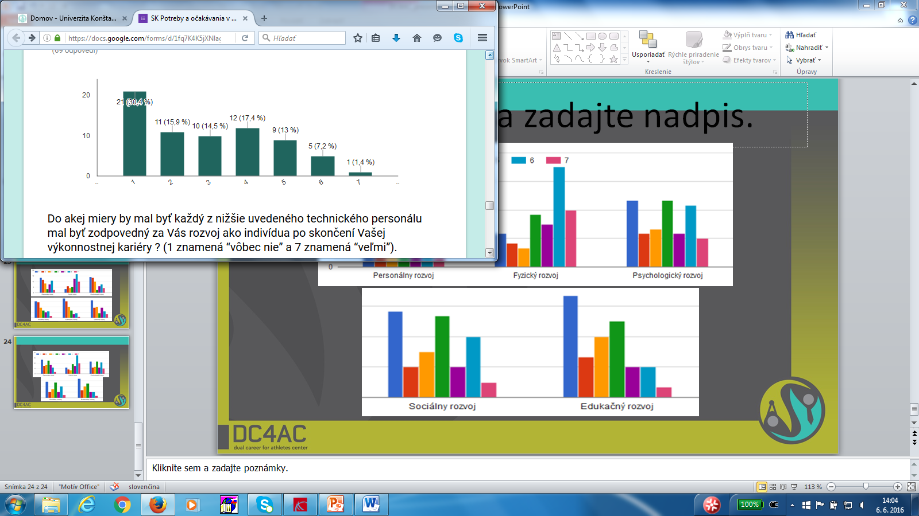
To what extent do you think that the technical staff members of your sport team are responsible for your development as an individual, beyond your sport performance career?

Slide 29
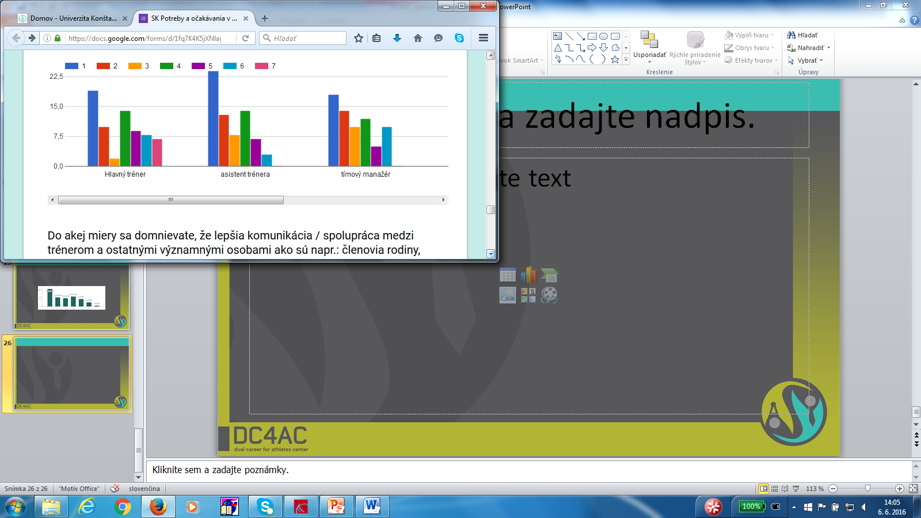
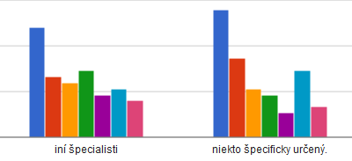
To what extent each of the technical staff members listed below should be responsible for your development as an individual, beyond your sport performance career ?

Slide 30
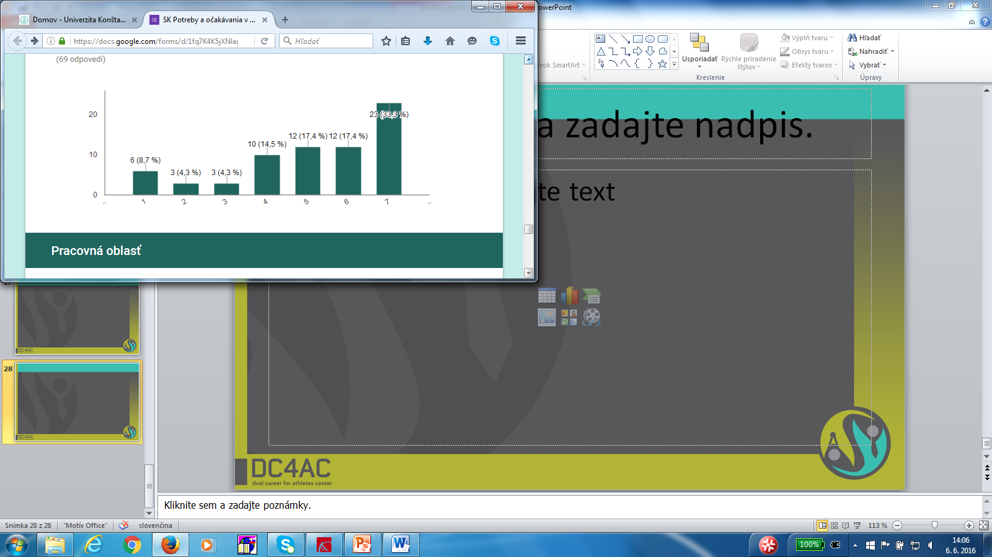
To what extent do you consider that a better communication / collaboration between coach and other significant persons such as: family members, partner would help you for developing a dual career?

Slide 31
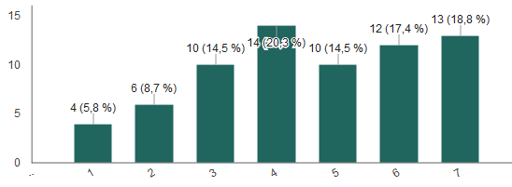
To what extent do you consider you would need a designated mentor to support you in the process of transitioning and developing a dual career?

Slide 32
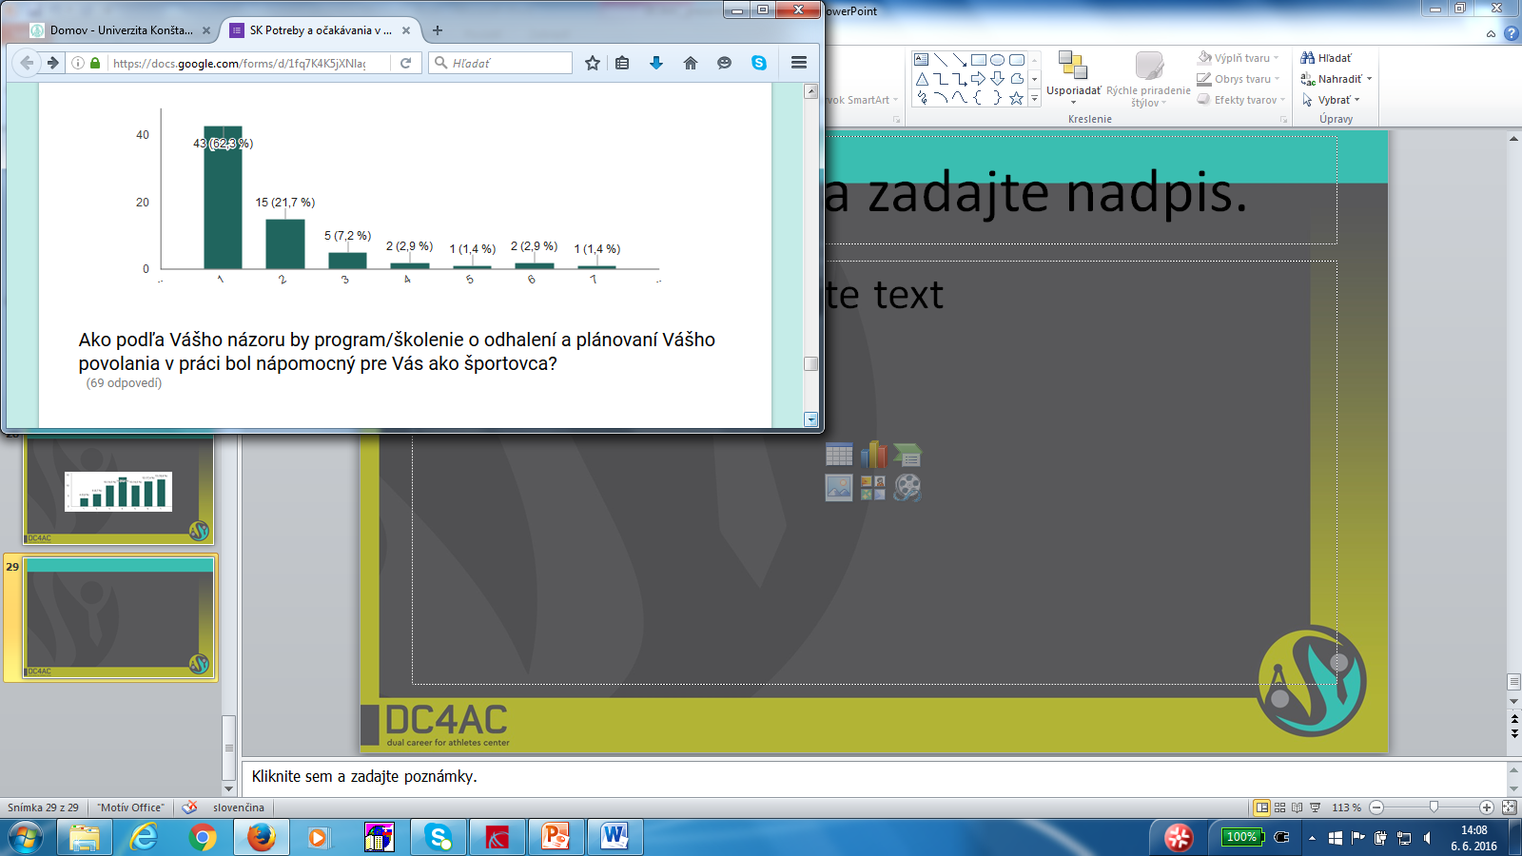
To what extent do you know about projects in your country that help athletes to find a work after their retirement from sport?

Slide 33
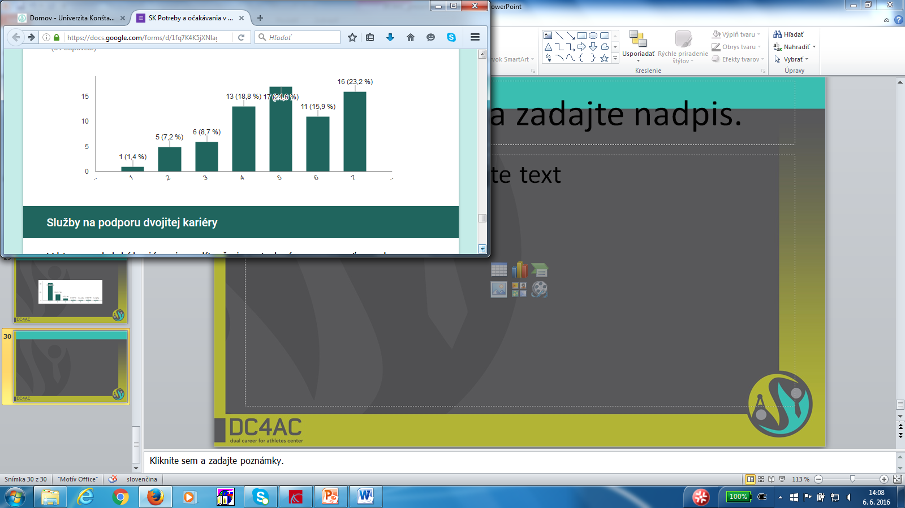
How much, in your opinion, a program/course of discovery and planning your vocation in work would be helpful for you as athlete?

Slide 34
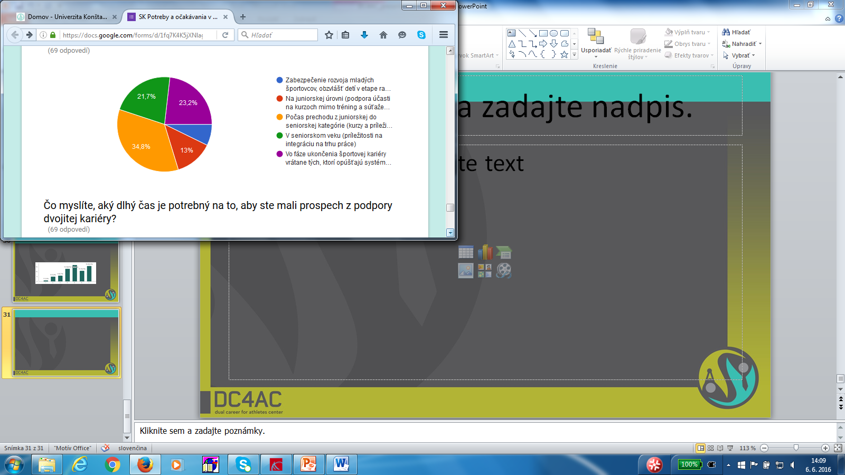
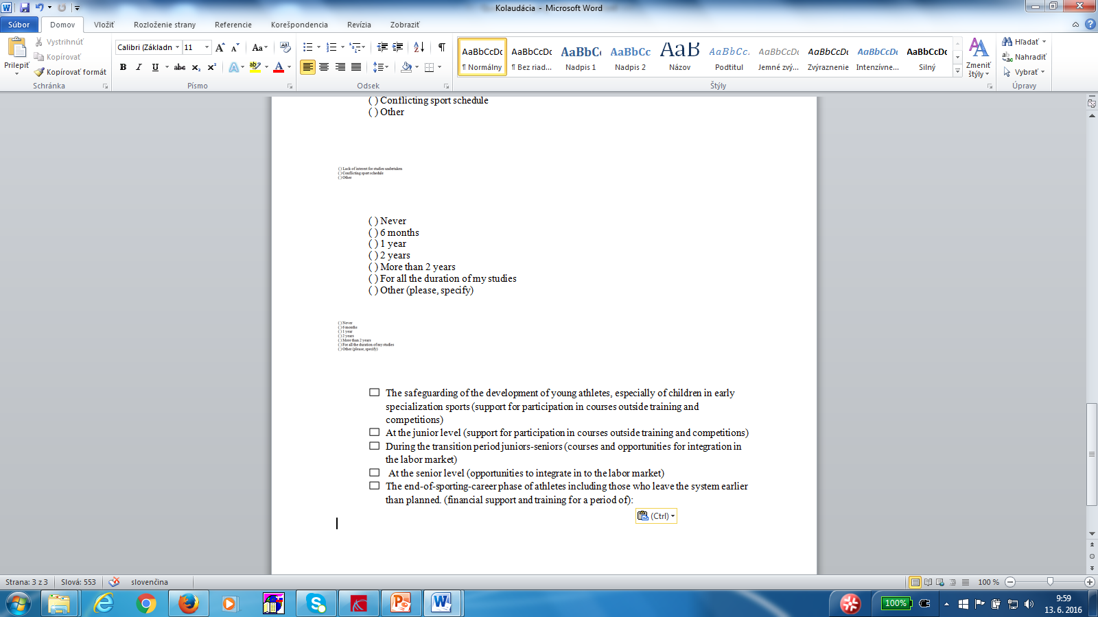
At what point in the performance career do you believe it is necessary to benefit from support for dual career:

Slide 35
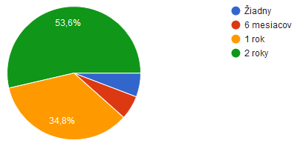
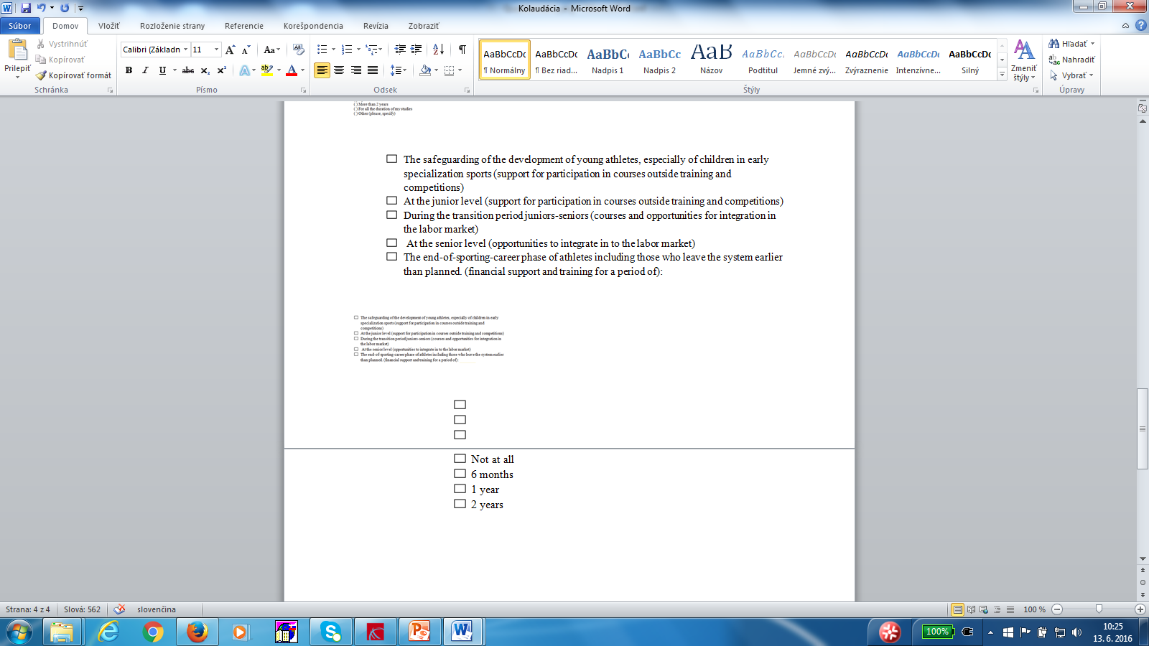
The end-of-sporting-career phase of athletes including those who leave the system earlier than planned. (financial support and training for a period of):

Slide 36
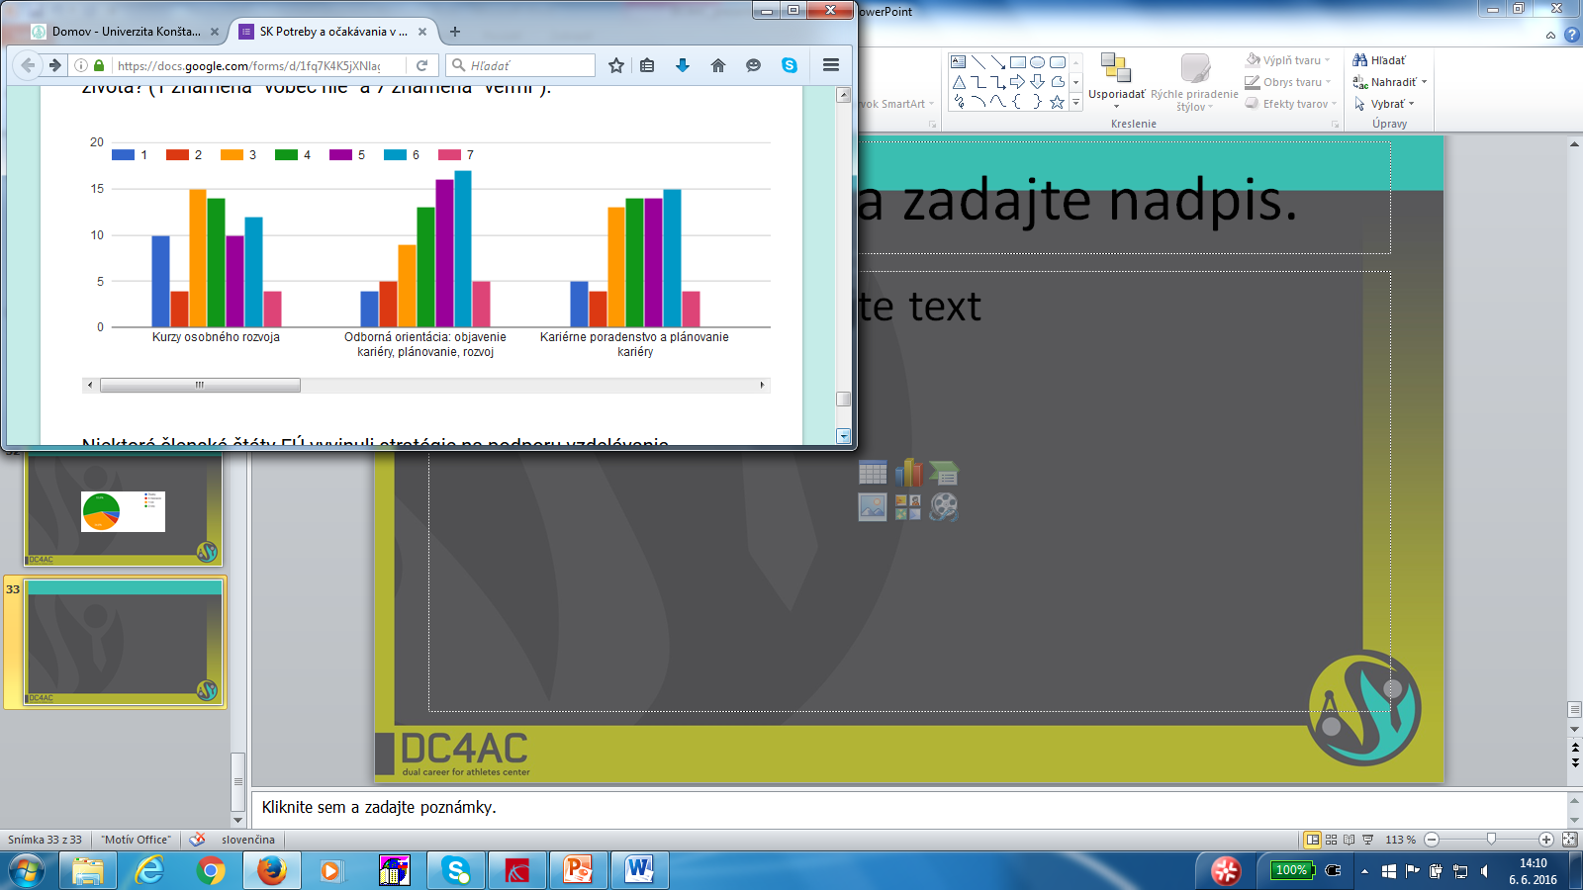

To what extent do you consider the following services are useful in order to feel more secure when ending sport performance career and transitioning to a next life stage?

Slide 37
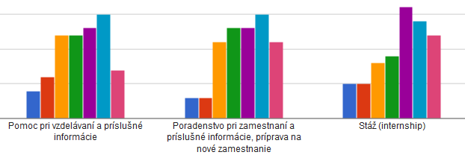
To what extent do you consider the following services are useful in order to feel more secure when ending sport performance career and transitioning to a next life stage?

Slide 38
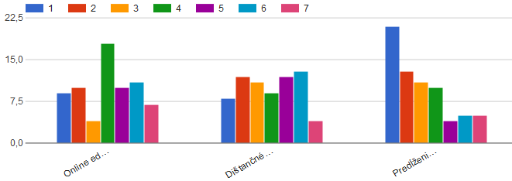
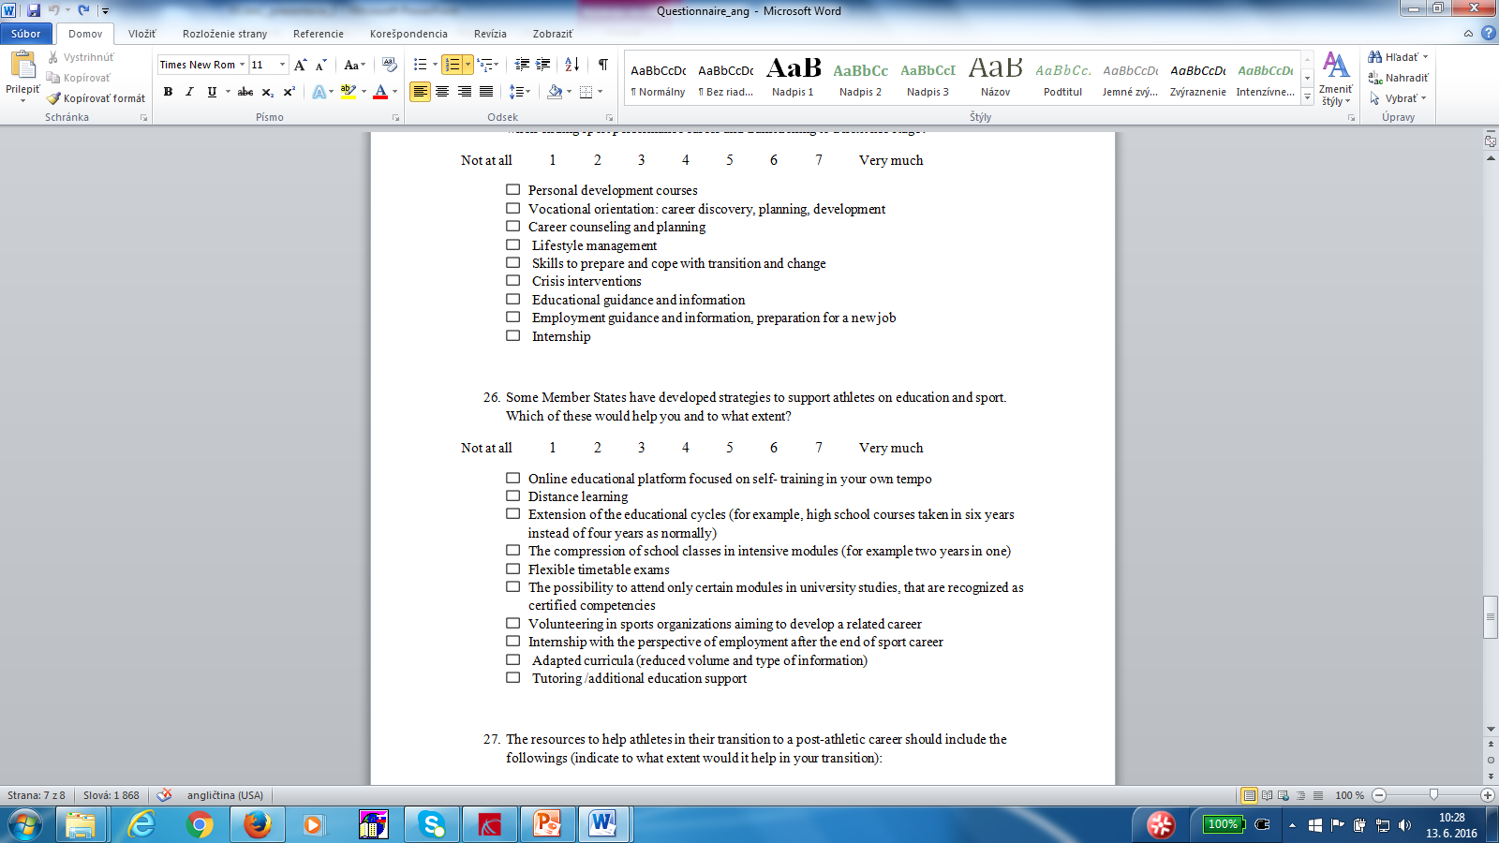

Some Member States have developed strategies to support athletes on education and sport. Which of these would help you and to what extent?

Slide 39
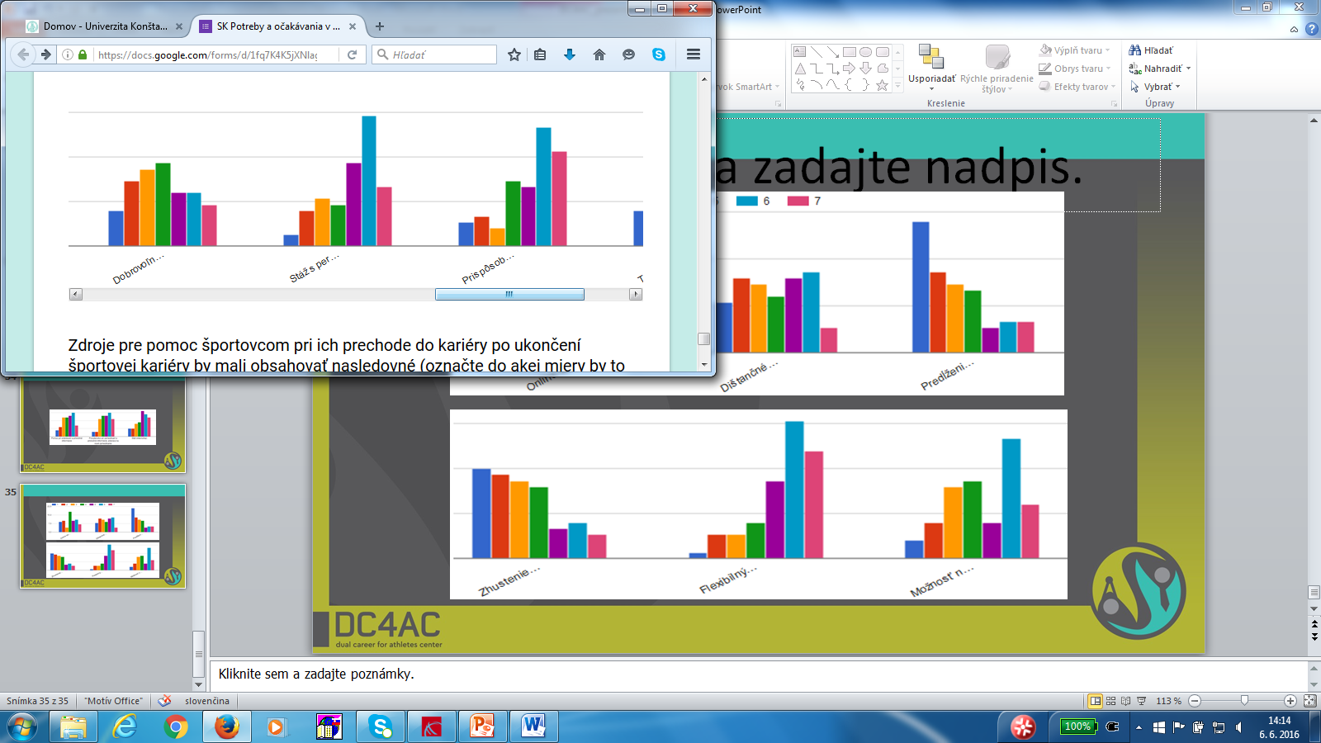
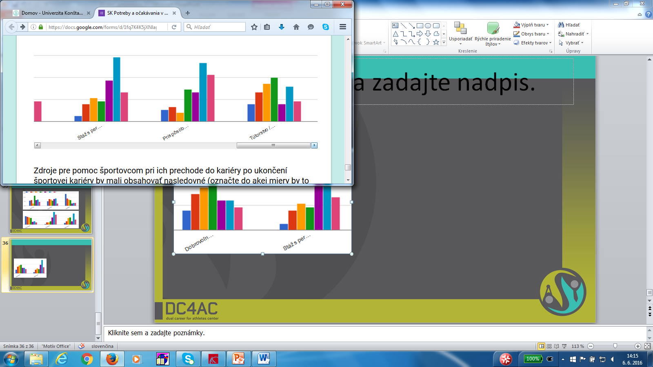
Some Member States have developed strategies to support athletes on education and sport. Which of these would help you and to what extent?

Slide 40
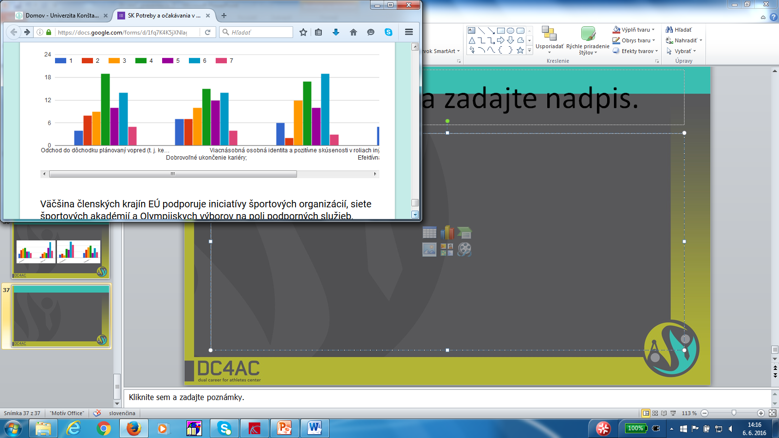
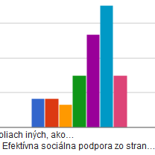
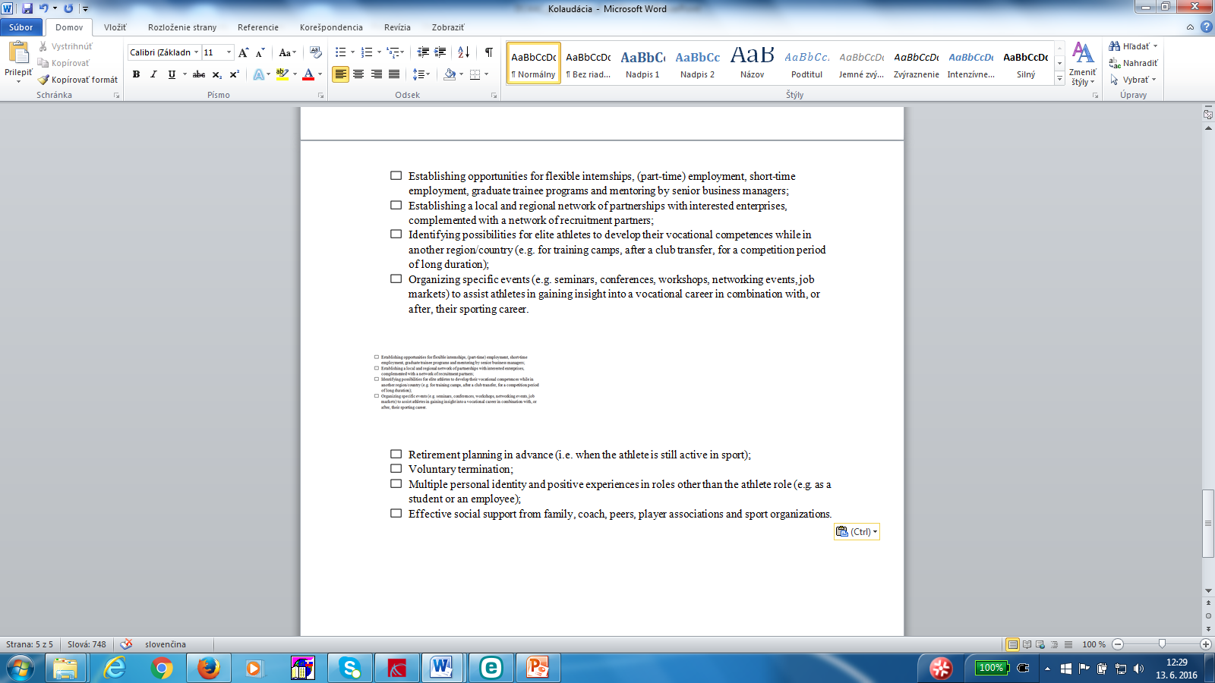
The resources to help athletes in their transition to a post-athletic career should include the followings (indicate to what extent would it help in your transition):

Slide 41
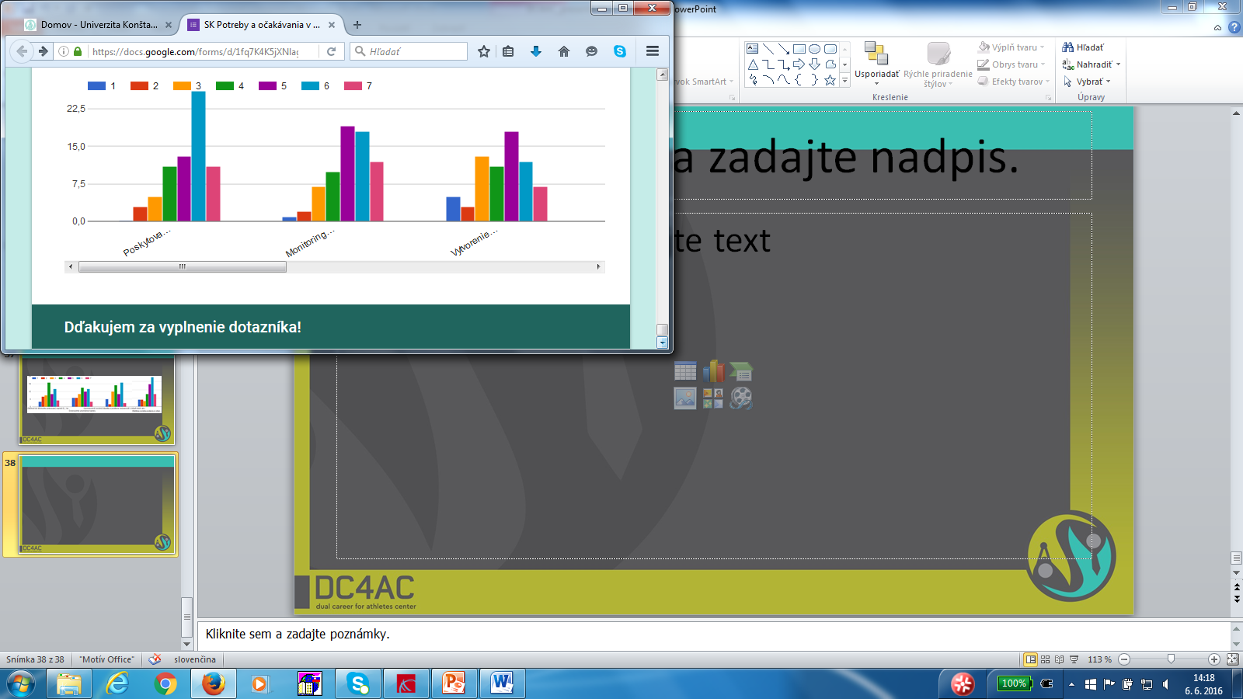

Most Member States encourage initiatives from sports organizations, sports academies networks and Olympic Committees in the field of supporting services. To what extent do you think the following would help you in an effective transition to a post-sport life?

Slide 42



Most Member States encourage initiatives from sports organizations, sports academies networks and Olympic Committees in the field of supporting services. To what extent do you think the following would help you in an effective transition to a post-sport life?

Slide 43
CONCLUSIONS
The new clasification of athletes into talented and elite ones would bring an additional recognition to them.
57% of athletes have finished at least one semester at univer.
65% of athletes were able to combine sport & educ./job.
25% of athletes are not prepared for life beyond sport career.
33% plan to stay in sport after finishing their sport career.
47% were put in a position to choose between sport perfor-
mance and education mainly due to conflicting sport schedule.
7. 48% of athletes think that they were not supported in the process of developing dual career at all.

Slide 44
CONCLUSIONS
8. Expectations of athletes:
Athletes expected more than they received
At least some financial support from state or association or individual arrangement from school
10% of athletes are unemployed
30% are professional athletes
8,7% have full-time employment
2,9% have part-time employment
29% study
29% are still at secondary school/transition to university

Slide 45
CONCLUSIONS
9. School should provide help during all petriod of study.
10. The period when athletes need support from school is the transition between junior and senior age (15-19 y.) and when they turn professional
11. 74% of athletes think a lot about what to do after finishing their sport career
12. Athletes think that parents/family, coach and partners are the main factors of support.
13. More than 1/2 of athletes think that there is a lack of support for athletes in Slovakia.

Slide 46
CONCLUSIONS
14. The organization is concerned only with athletes´ physical development
15. 82% of athletes think that there should be a better communication between them and the coach, family, partner and other involved persons.
16. More than 70% think there should be a designated mentor in the process of developing a dual career.
17. 91% of athletes do not know any DC project !!!!!
18. 82% think that such a programme would be very helpful, especially in professional orientation, planning and developing career.

Slide 47
CONCLUSIONS
19. Athletes would appreciate most:
Assistance at Education
Consultancy
Internships
Flexible timetables
Effective social support from family, coaches, peers, associations and organizations.

